Slide 2
PERIOD END CLOSING EXECUTION (BSC)

Slide 3


Period End Closing Execution (BSC)
Period End Closing Overview
Period End Closing Key Process Areas and New Period End Checks
Post Closing Activities
Year End Specific Closing Activities

Slide 4

Period End Closing Execution (BSC) - About this course
Course Objectives
This course is intended to provide instructions on how to execute Period End Closing tasks outside of Financial Closing Cockpit (FCC¹⁾), helping users understand the process logics, equip them with the required knowledge to perform testing and troubleshooting, and carry out period end closing in case FCC cannot be used in exceptional circumstances.
Upon completing this course, users will be able to:
Understand and execute month end activities that the BSC is responsible for
Understand and execute year end activities
Execute post period end activities in S/4HANA
Target Audiences
This course is mandatory for BSC users who are responsible for executing Period End Closing in S/4HANA Parallel Ledger environment
Learning Guide
Prerequisite Courses:
Finance Fundamentals – Overview
Finance Fundamentals – Master Data
Period End Closing Overview
Courses in the following subject areas should be completed by users who are responsible for Period End Closing of these processes before attending this course ²⁾:
Asset Accounting
Accounts Receivables
Accounts Payables
Parallel Ledgers
Cash Management
Financial Supply Chain Management (FSCM)
Profitability Analysis
Cost Management
Product Costing
Intercompany Non-trade
¹⁾ FCC - Financial Closing Cockpit
²⁾ Refer to S4F Training Portal for detailed list of courses.

Slide 5
Period End Closing Execution (BSC)
Period End Closing Overview
Period End Closing Key Process Areas and New Period End Checks
Post Closing Activities
Year End Specific Closing Activities

Slide 6
Period End Closing Execution (BSC)
Period End Closing Process Overview
Period End Closing Overview
FCC Variants Overview

Slide 7







JT-JTI Period End Closing Model
GBS (Warsaw, Manila, Saint-Petersburg) and JT BC (Japan): coordination of PEC in liaison with Entities
Entities: responsible for the correctness of their Market and Entity financials (incl. IFRS, STAT, TAX books)
GSC: Centrally control Material Ledger closing
Corporate Accounting: In charge of consolidation and IFRS reporting.
Global Performance Management: In charge of Management Reporting.
“Best in class” financial closing and reporting: fastest possible disclosure of performance results to investors and management
Closing of P1-P11 is based on Geneva (JTI HQ location) calendar.
Closing of P12 is based on Hybrid calendar (Jan 1-3 are treated as non-working days)
Closing of IFRS, Statutory and Tax ledgers will be executed monthly
Closing of Statutory Extension Ledger S1 and Tax Extension Ledger T1 will be executed annually
Financial Closing Cockpit (FCC) automates closing tasks for all core ledgers.
Period End Closing processes is part of Global Reference Model (GRM) .
Any exceptions/deviations from PEC GRM , driven by legal/statutory requirements, are documented/approved by R2R Competency Center.
Vision
Scope and Frequency
Roles and Responsibilities
Tools
Governance

Slide 8


Key Period End Closing Timelines
Monthly ledger closing:
IFRS Ledger closing cut-off - remains as is on WD3.
Statutory Ledger closing cut-off established on WD10. ¹⁾
No monthly closing of posting periods for Statutory Extension Ledger S1 (i.e. all remain open until the annual cut-off date).
Tax Ledgers closing cut-off established on WD10 (will be closed in parallel with Statutory ledger). ¹⁾
No monthly closing of posting periods for Tax Extension Ledger T1 (i.e. all remain open until the annual cut-off date).
Annual ledger closing:
Although we reserved special posting period P13 as a placeholder for IFRS reporting adjustments, based on JTI practices with the close of P12 on WD3 in January, IFRS ledger is closed and ready for annual reporting.
Statutory Ledger closing cut-off - end June for YE manual ledger specific postings (FA, ML–COGM, AP, AR, CM, FSCM will need to be closed as per monthly calendar).
Statutory Extension ledger S1 closed only annually – end of June.
Tax Ledger closing cut-off - end September for YE manual ledger specific postings (FA, ML -COGM, AP, AR, CM, FSCM will need to be closed as per monthly calendar).
Tax Extension ledger T1 closed only annually - end September.
Use of Posting Periods:
Standard Posting Periods P1-P12 to be used for bookings in IFRS and any compulsory monthly activities for STAT and TAX.
Special Posting Periods: P13-P16 are sustained, however each has been assigned with a specific usage (see Period End Overview course for further details).
¹⁾ Exceptions exist. See Period End Closing Overview course. For JT the STTX cut-off day is WD07.

Slide 9
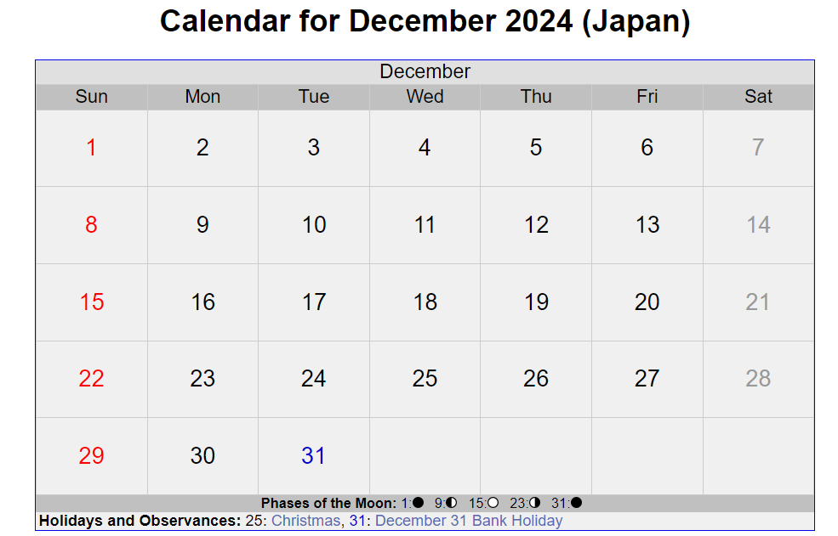
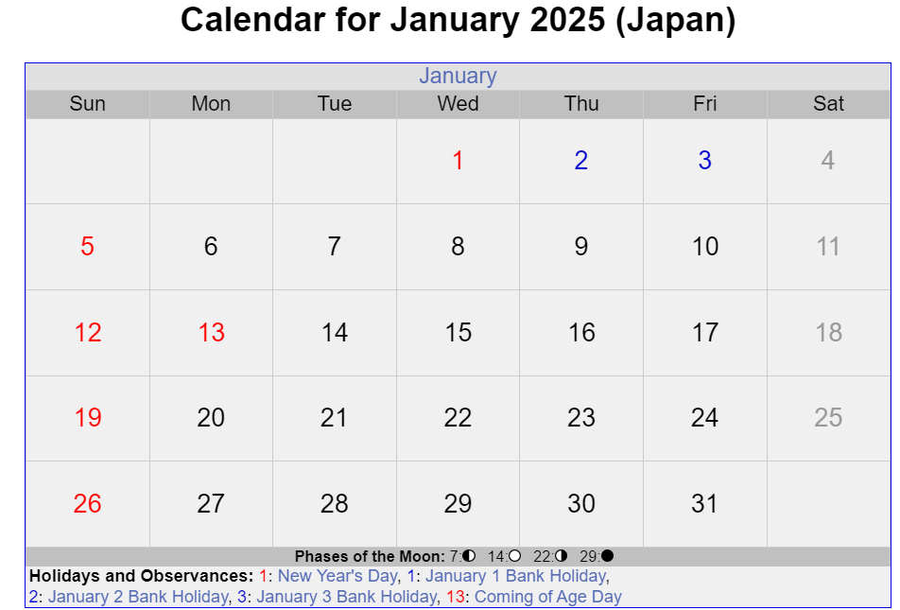
Holiday Calendar- Exception Japan & Geneva Hybrid Calendar
Japan should follow the Geneva Calendar for the Closing Periods P1-P11.
Starting from P12 2024 closing, the closing calendar will be based on Hybrid calendar (Jan 1-3 are treated as non-working days). This is applicable to all JTI.
Closing of P12 (2024)
In January 2025, the 1st Working Day, would be 6th of January. This is applicable to all JTI.

Slide 10
What Happens During Period End Closing?
Logistic modules closing
FI Sub-ledgers closing ¹⁾
Core closing activities ²⁾
Statutory/Tax Ledger specific closing activities
New MM period opened to allow goods movements start to be booked in the new period
Cease of logistic transactions affecting accounting, e.g.
All goods receipts/goods issue/billing for the period are posted
All logistic invoices for the period are posted
All material movements impacting accounting are posted
Sub-Ledgers in FI are closed
AR (incl. Interco)
AP (incl. Interco)
Asset Accounting (including EAM WBS settlement)
Transactions from other sub-accounting processes are posted to General Ledger
Payroll
T&E
Cash/In House Bank
Treasury deals/calculations
Nakisa Lease Accounting
FI General Ledger Closing
Accrual and Recurring Entries runs
GR/IR closing
VAT clearing and reclassification
FX Revaluation (IFRS only)
AP/AR Regrouping (IFRS only)
Translation (CTA) (IFRS only)
CO Cost Management Closing
Cost Center postings finalized
Leaf Internal Order closing
WBS settlement (Opex, Above Brand Contribution) and Multi-brand WBS allocation
Product cost/Material Ledger closing (IFRS only)
Consolidation
Consolidation checks completed
IFRS Financial Statements preparation
Statutory/Tax Ledger Month end postings
Functional Area adjustments
FX Revaluation
AP/AR Regrouping
FX Translation (CTA)
Product cost/Material Ledger closing
Tax Perms Tagging Cockpit
Year end only
Country by Country (CbC) Reporting
Taxable Income Report
Japanese Controller Foreign Company (JCFC) Reporting (to become largely system based as of fiscal year 2020).
¹⁾ Closing in these areas are performed for all ledgers at the same time
²⁾ If no ledger is specified for a given activity in this section, it means that closing is taking place in all ledgers in this activity/step.

